Slide 1

Application website for amaz0n
sudmitted by: Nallabothu Shailaja 192011163

Slide 2


AIM :- TO ANALYSE e-commerce application for amaz0n.

Slide 3
Requriments
1.INTERNET CONNECTION
2.USER NAME (E –MAIL)
3.PASSWORD
4.WEBSITE(www.amazon.in)

Slide 4
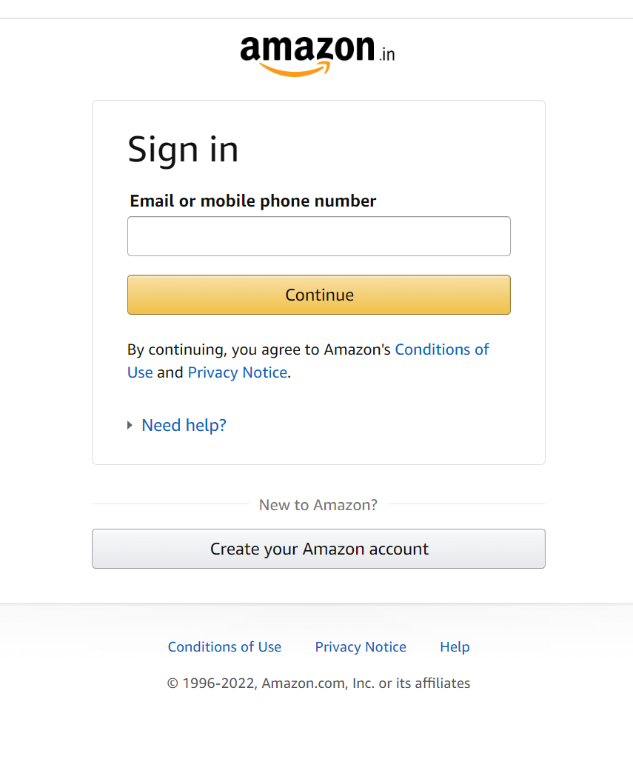
Amazon login page

Slide 5
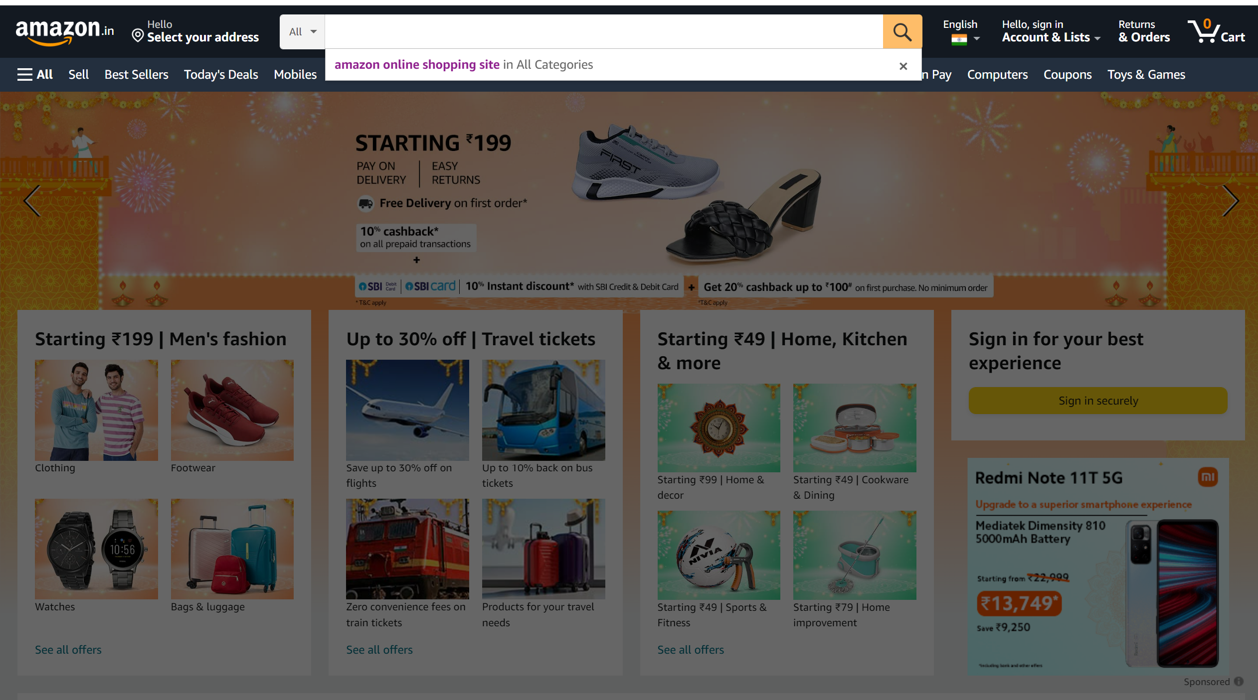
Searching page

Slide 6
POSITIVE TEST SCENARIO
Enter Valid email or mobile number.
Enter Valid Password.
Click on “Forgot Password” Link and find out forgot password page.
Click on Create new account button and verify if it takes to new account page.
Select “Keep me signed in” option to retain login session
Select “Help” option to get help from amazon.
Select “Privacy Note” to get amazon privacy polices page.
In Forgot page –Enter the OTP(One Time Password) to recreate the amazon password.
Clicking on the “product image” .It directly takes to the product page.
Clicking on the “Buy Now “ link Button. It directly takes to the payment page.

Slide 7
Negative test scenario
Enter invalid username and valid password.
Enter valid username and invalid password.
Enter invalid username and password.
Keep one field blank either username or password and check login.
The price on the image and the the on the prodect was mostly different.
The payment declain was high in the amazon pages.
Need to improve the return and replacement options.
Need to improve the UI(USER INTERFACE) on the web site.
When the network was slow the was buffer on that time.
On searching one product It shows different products

Slide 8
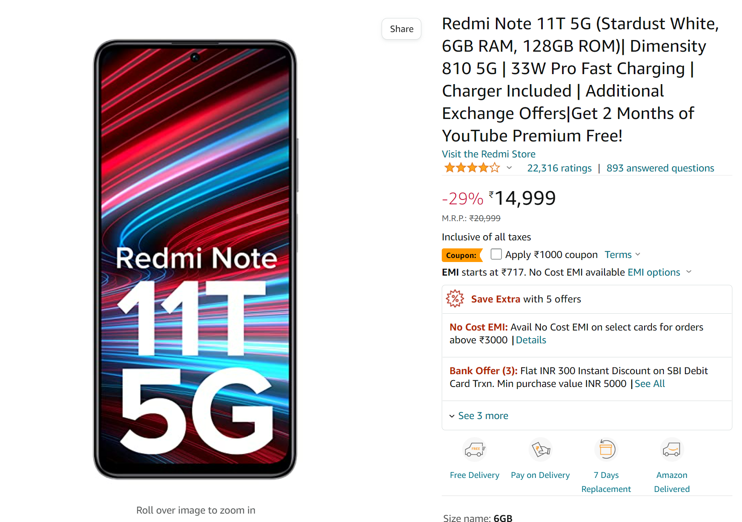

Product difference in Image and product page

Slide 9
TEST CASES
Test cases | Type – negative/positive
Verify if a user will be able to login with valid username and valid password. | Positive
Verify if a user cannot login with a valid username and an invalid password. | Negative
Verify the login page for both ,when the field is blank and submit button is clicked. | Negative
Verify the forget password functionality. | Positive
Verify the messages for invalid login. | Positive
Verify the not remember me functionality. | Negative
Verify if the data in password field is either visible as asterisk bullet signs. | Positive
Verify if user is able to login with a new password only after he\she has changed the password. | Positive
Verify if user able to identify the price difference in image and the product page | Negative
Verify if user search for product and it does not show the product | Negative

Slide 10

E commers make life very easy to shop
By
Nallabothu Shailaja 192011163

